Slide 1
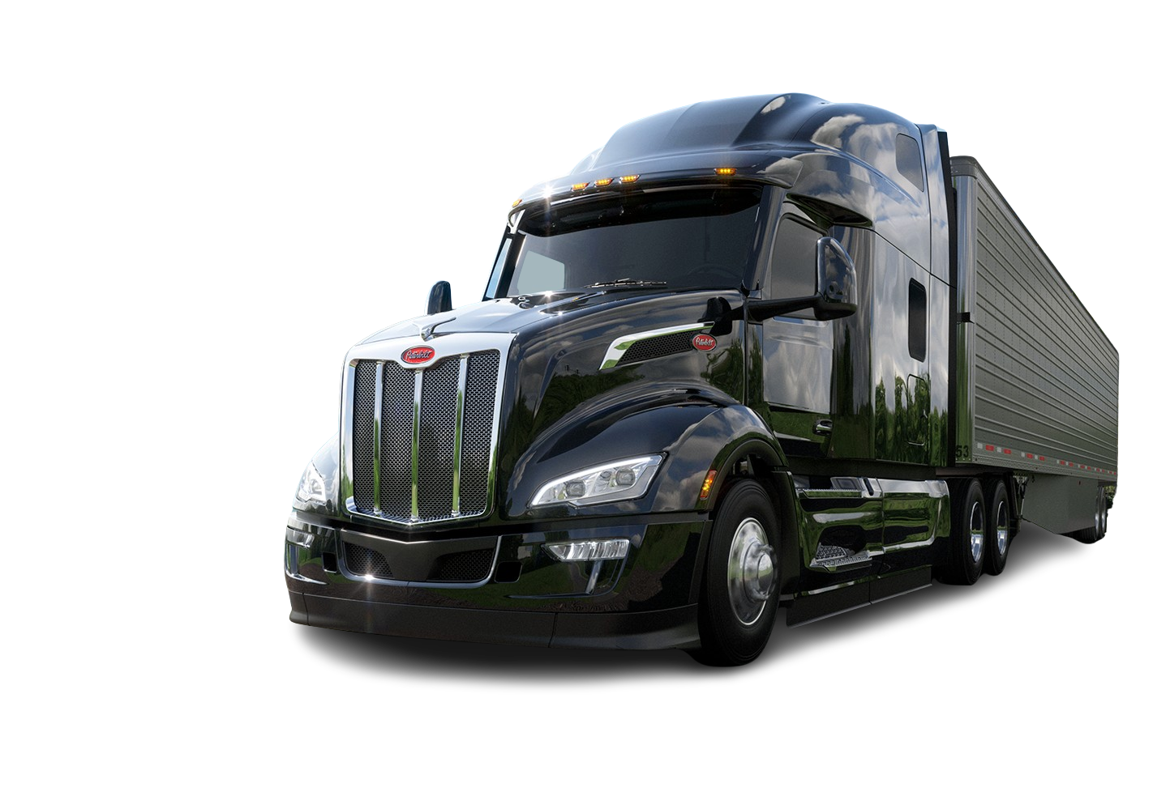

Multivariate Insights into Vehicle Attributes and Warranty Claims
Data Hunters:
Sirisha Poolakunta Ramesh
Keerthi Malathkar
Sri Charan Bodduna

Slide 2
Problem Statement
Understanding warranty costs is vital for Peterbilt Motor Company as these costs have significant financial and operational implications. High warranty claims can erode profit margins, especially for a company that offers a wide range of customizable truck configurations. By identifying which vehicle attributes or combinations of attributes contribute to higher warranty costs, Peterbilt can make more informed decisions on vehicle design, improve product reliability, and ultimately reduce the financial burden of warranty claims, enhancing both profitability and customer loyalty.
We are addressing the below three problem statements.
1. Which individual attributes or option codes are significantly associated with increased warranty costs?
2. Are there specific pairs of attributes that interact in a way that exacerbates warranty claims?
3. What modeling approaches can effectively quantify these relationships and offer predictive insights for future vehicle configurations?

Slide 3
Individual attributes impact on increased warranty costs
Problem
Which individual attributes or option codes are significantly associated with increased warranty costs?
Solution
Rank | Attributes | Options
1 | 7 | 290
2 | 6 | 281
3 | 2 | 83,158
4 | 1 | 1,60

Slide 4
Specific Attribute Pairs that Amplify Warranty Claims
Problem
Are there specific pairs of attributes that interact in a way that exacerbates warranty claims?
Solution
Rank | Attributes
1 | 7,6
2 | 7,2

Slide 5

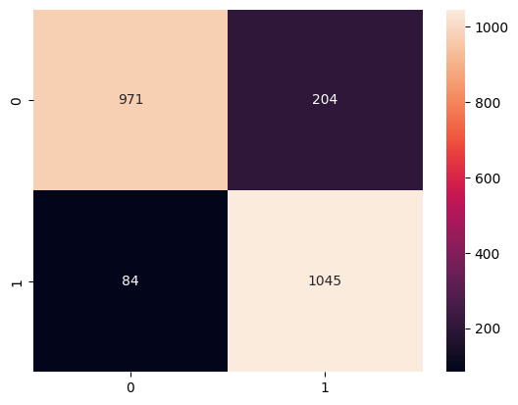
Modeling
Target classes:
Very High/High: 1
Medium/Low/Very Low: 0
Implemented XGBoost modeling
Highest accuracy achieved is 88%
Being correctness: 92% (precision)

Slide 6
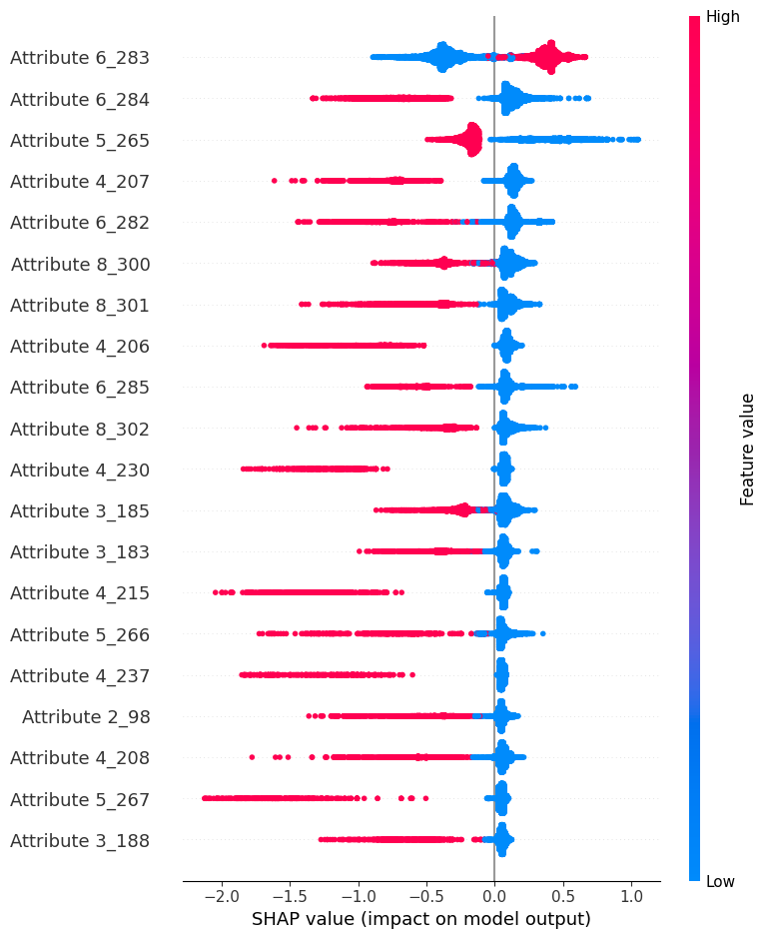
Modeling Results Interpretations
​Key truck configuration attributes influencing claim classification include “Attribute 6,” “Attribute 5,” and “Attribute 2.”
“Option code 283” in “Attribute 6” is critical, as its presence is linked to higher claim costs.
The chart illustrates the relationship between claim costs and top feature attributes, with red indicating high claim costs and blue for lower claims.
Option Code “Attribute 6_283” correlates with higher claims, while the absence of “Option code 284” in “Attribute 6” aligns with lower claims.

Slide 7
Key Takeaways
Targeted Quality Improvements: Attributes with very low p-values (such as Attributes 6 and 7, or Attributes 2 and 7) indicate significant interactions that likely drive higher warranty costs. By focusing on these attribute pairs, the company can address specific quality issues in the design or manufacturing of these components, leading to reduced claims and lower costs.
Optimized Product Configurations: Some attribute pairs, such as (Attribute 1, Attribute 6) and (Attribute 2, Attribute 5), also show strong associations with higher claim rates. For future products, the company could limit or offer alternative configurations for these specific attribute combinations, which would reduce the likelihood of costly warranty issues in the field.
Informed Customer Recommendations: Insights from these attribute combinations could also be shared with customers in fleet or bulk sales. The company could advise customers on product configurations that are less likely to incur high warranty costs, enhancing customer trust and helping to position the company as a proactive partner in managing long-term vehicle reliability.

Slide 8


